Slide 1

TEXT-TO-IMAGE GENERATOR
Project By:
Darshan R 1st21cs057
Deeksha M 1st21cs058

Slide 2
Introduction
Creating a text-to-image generator using OpenCV and Diffusers combines computer vision and advanced models to turn text descriptions into realistic images. OpenCV is a powerful library that helps process and edit images efficiently. Diffusers, an advanced generative model, can produce high-quality images based on the input text. This project highlights how natural language processing and image generation can work together, opening up exciting possibilities for the future of AI creativity. With these technologies, we can develop new applications in art, design, advertising, and content creation.

Slide 3
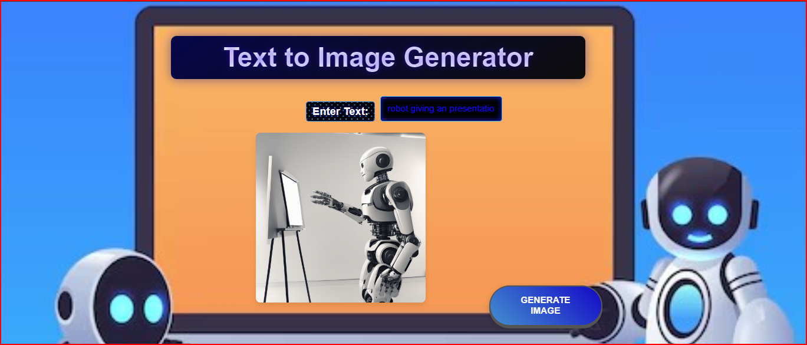
Project Workflow

Slide 4
Project Workflow
Step1.
The Mapped Datasets are considered which containing Image and the Description of the Image
Step2.
The model is Trained for the numerous datasets with the concepts of NLP and Image Diffusion
Step3.
Using OpenCV and other supporting libraries the Image corresponding the Description is generated.
Step4.
The model is used in an Flask App Development for the External usage

Slide 5
Libraries used
OpenCV:
OpenCV (Open Source Computer Vision Library) is a powerful and widely-used open-source library for computer vision and machine learning. It provides tools for real-time image processing, enabling tasks such as object detection, face recognition, and image transformation. With its extensive collection of algorithms and support for multiple programming languages, OpenCV is a go-to resource for developers and researchers in the field of computer vision.
Diffusers:
Diffusers are advanced generative models that transform text descriptions into detailed and realistic images through a process called diffusion. They work by iteratively refining an initial random noise image, guided by the input text, to produce high-quality visuals. In the context of text-to-image generation, Diffusers excel at capturing intricate details and accurately representing the described scenes.

Slide 6
Future Scope
Achieve faster and more efficient real-time image generation to enhance user experience in interactive applications.
Incorporate additional modalities, such as audio or video, to create richer and more dynamic content.
Implement personalization features that allow users to influence and customize the generated images based on their preferences and previous interactions.
Ensure that the generated content is free from biases and adheres to ethical standards.
Enable models to adapt to different domains and styles by training on diverse datasets and incorporating domain-specific knowledge.

Slide 7
Conclusion
In conclusion, our text-to-image generator using OpenCV and Diffusers demonstrates the exciting possibilities of merging computer vision and generative models. By harnessing OpenCV's powerful image processing capabilities and the advanced text-to-image generation skills of Diffusers, we can create detailed and realistic images from simple text descriptions. This project highlights the potential for innovative applications in art, design, and advertising, showcasing how AI can enhance creativity and provide practical solutions across various fields.

Slide 8
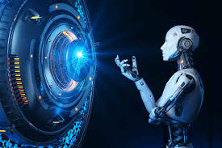
Thank You

